Slide 1
Handoff
By Rohit (44)

Slide 2
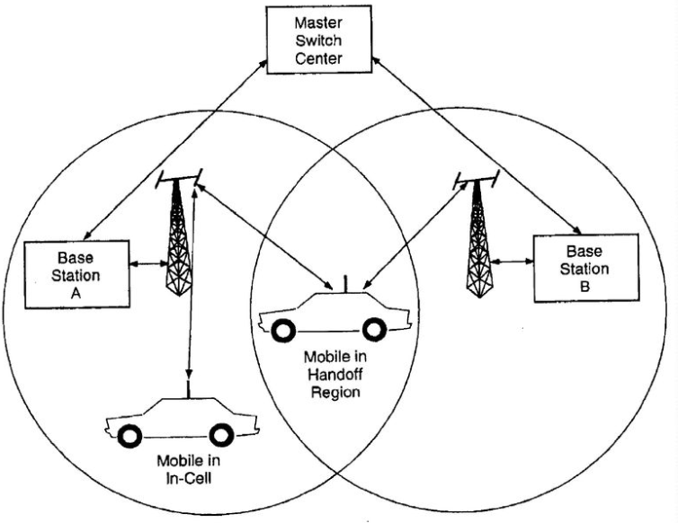
Handoff
Handoff refers to the process of transferring ongoing call or data connectivity from one Base Station to other Base Station
When a mobile moves into the different cell while the conversation is in progress then the MSC transfer the call to a new channel belonging to the new Base Station.
Handoff is necessary for preventing loss of interruption of service to a caller or a data session user.

Slide 3
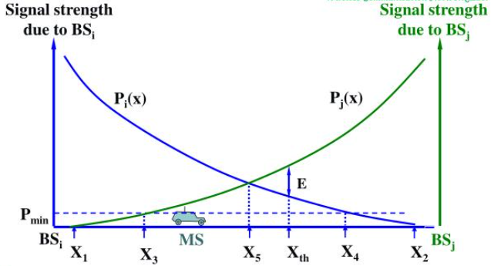
Need of Handoff
As the user (MS) moves away from the BS, the signal strength of that BS reduces. However, the signal from another (now closer) BS grows, and a handoff is imminent.
One of the building blocks of cellular communication is mobility
Handoffs play a major role in allowing users to move across cells without the fear of being disconnected.

Slide 4
Need of Handoff
MS move out coverage of one cell and enter coverage area of another cell
When capacity of a cell is exhausted
When there is an interference of calls using the same frequency for communication.

Slide 5
Type of Handoff
Hard Handoff
Soft Handoff

Slide 6
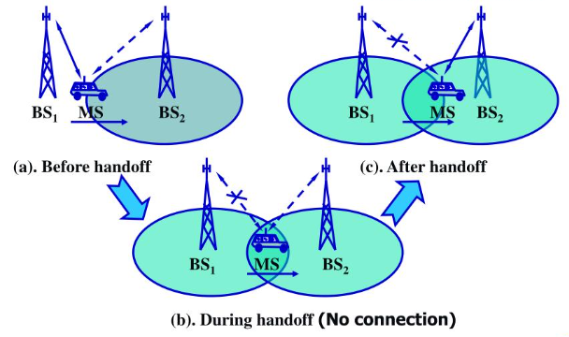
Hard Handoff
When there is an actual break in the connectivity while switching from one Base Station to another Base Station
Break Before Make policy
Only one connection during handoff
Slight disturbance

Slide 7
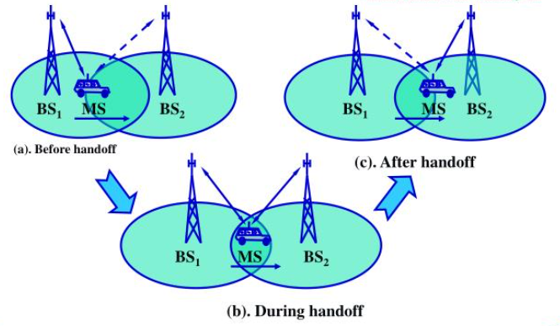
Soft Handoff
First switching the connection to new base station establishing the connection and then terminating the connection
Make Before Break policy
MS is always connected to atleast one base stations during handoff

Slide 8
Hard vs Soft handoff
Hard Handoff | Soft Handoff
It is defined as hand-off where an existing connection must be broken when the new one is established. | It is defined as hand-off where a new connection is established before old one is released.
Cheaper in cost | Expensive the hard handoff
Only one connection at a time (some time no connection) | Always have at least one or more connection at a time
Slight Disturbance | No disturbance
It allocates different frequency. | It allocates same frequency.
Less complex when compared to soft hand-off. | It is more complex than hard hand-off.

Slide 9
Reference
https://www.tutorialspoint.com/handoff-in-mobile-connections
https://www.ques10.com/p/54549/explain-hard-hand-off-and-soft-hand-off-1/
https://technobyte.org/handoff-types-mobile-communication-wireless-network/
https://www.geeksforgeeks.org/handoff-in-cellular-telecommunications/
https://webeduclick.com/difference-between-hard-handoff-and-soft-handoff/

Slide 10
Thank You

